Slide 1

MATH 323
Graph Theory
Cr. 3
Dr. Bhadra Man Tuladhar
MATH 323 Graph Theory Lec. 4

Slide 2
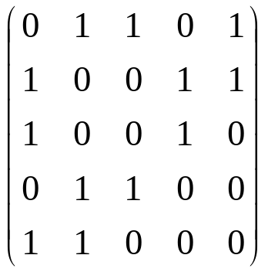
Matrix Representation
Let V = {v₁ … v_{n} } be ordered. The adjacency matrix of G is the n×n-matrix M with entries M_{ij} = 1 or M_{ij} = 0 according to whether v_{i}v_{j} ∈ E or not.
2
4
A graph has usually many different adjacency matrices.
1
3
5
G
Adjacency Matrix
MATH 323 Graph Theory Lec. 4

Slide 3
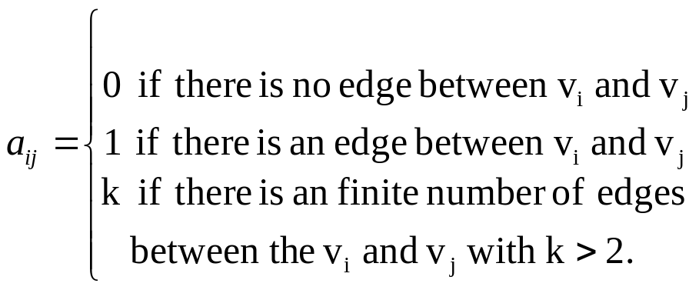
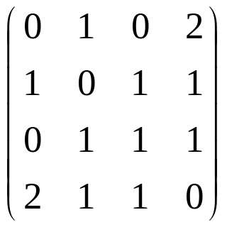

Adjacency matrix of multigraph
The adjacency of a multigraph G is defined as:
A
B
G
Adjacency matrix
C
D
MATH 323 Graph Theory Lec. 4

Slide 4
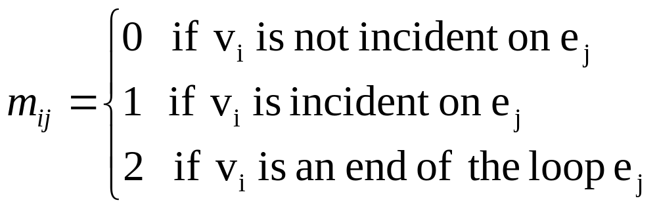
Incidence matrix
For a graph G with m vertices and n edges, the incidence matrix of G is defined as M(G) = (m_{ij})_{m×n}, where:
MATH 323 Graph Theory Lec. 4

Slide 5
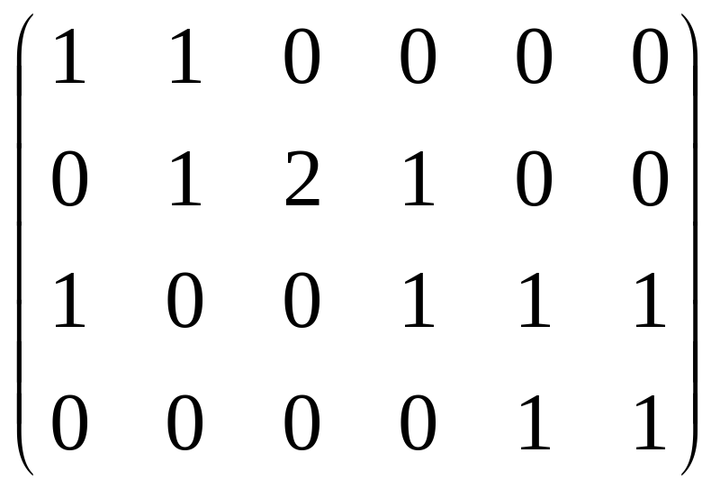
Incidence matrix
Incidence matrix of G:
v₁
e₂
e₃
v₂
e₄
e₁
e₅
v₄
v₃
e₆
MATH 323 Graph Theory Lec. 4

Slide 6
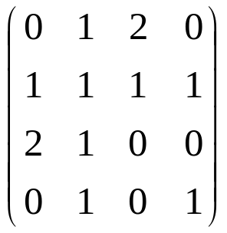
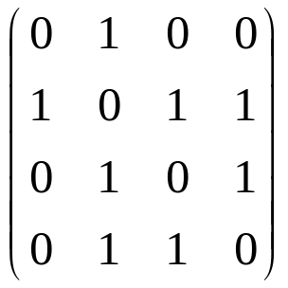
Exercise
Draw the graph whose adjacency matrix is:
Find the adjacency and incidence matrixes for
a.
b.
a
c
b
d
e
f
g
MATH 323 Graph Theory Lec. 4

Slide 7
Isomorphism of Graphs
Definition. Two graphs G and H are isomorphic, denoted by G ≅ H, if there exists a bijection :
α: V_{G} → V_{H} such that
uv ∈ E_{G} ⇔ α(u) α(v) ∈ E_{H}
for all u, v ∈ G.
2
G and H are isomorphic.
a
b
1
4
e
c
3
5
d
G
H
MATH 323 Graph Theory Lec. 4

Slide 8
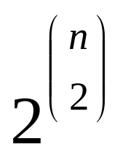
Graphs with n vertices
For a given set of n vertices,
we can make graphs.
n | 1 | 2 | 3 | 4 | 5
G | 1 | 2 | 8 | 64 | 1024
Non-Isomorphic | 1 | 2 | 4 | 11 | 34
MATH 323 Graph Theory Lec. 4

Slide 9
Theorem
Two graphs G and H are isomorphic if and only if they have a common adjacency matrix. Moreover, two isomorphic graphs have exactly the same adjacency matrices.
MATH 323 Graph Theory Lec. 4

Slide 10
Isomorphic or not?
To prove G ≅ H, we give names to the vertices, provide a bijection between the vertex sets, and verify that the adjacency relation is preserved.
1
2
a
d
6
3
b
e
c
f
5
4
MATH 323 Graph Theory Lec. 4

Slide 11
Isomorphic using matrix
The graphs G and H are isomorphic if and only if we can apply a permutation to the rows of A(G) and the same permutation to the columns of A(G) to obtain A(H).
w
y
c
d
x
z
a
b
G
H
MATH 323 Graph Theory Lec. 4

Slide 12
Isomorphic or not?
If the graphs have many edges, we prefer to compare their complements.
Graphs G and H are isomorphic if and only if their complements are isomorphic.
G
H
MATH 323 Graph Theory Lec. 4

Slide 13
Compliments
Compliment of G
Compliment of H
not connected
connected
They are not isomorphic.
MATH 323 Graph Theory Lec. 4

Slide 14
The Petersen Graph
Petersen graph is a 3-regular graph of order 10.
Construct the Peterson graph
MATH 323 Graph Theory Lec. 4

Slide 15
Automorphism
An isomorphism of G onto G is called an automorphism.
The automorphisms of G are the permutations that can be applied simultaneously to the rows and columns of A(G) without changing A(G).
MATH 323 Graph Theory Lec. 4

Slide 16
Example of automophism
1
2
4
3
4
3
1
2
These two graphs are automorphic.
Interchanging vertex 1 and vertex 2 is not an automorphism of G.
MATH 323 Graph Theory Lec. 4

Slide 17
Self-complementary
A simple graph isomorphic to its compliment is self-complementary.
b
1
5
a
c
2
4
3
e
d
MATH 323 Graph Theory Lec. 4

Slide 18
Exercise
1. Show that the graphs G and H are isomorphic.
G
H
MATH 323 Graph Theory Lec. 4

Slide 19
Exercise (contd.)
Is the graph given below isomorphic to the Peterson graph?
MATH 323 Graph Theory Lec. 4

Slide 20
Exercise (contd.)
The riddle of Alcuin (735-804)
A shepherd was to cross a river by boat. He had with him a wolf, a lettuce and a goat. The boat can carry only the shepherd an one of the three. As is well known a wolf eats the goat and the goat eats the lettuce, if left unguarded on the same bank of the river.
How does the shepherd bring all three on the opposite bank using graphs?
MATH 323 Graph Theory Lec. 4

Slide 21
Exercise (contd.)
Using graph, find the shortest solution of the maze given below.
MATH 323 Graph Theory Lec. 4

Slide 22
Check!
How many digits does 100! have?
Which is larger, n! or 2^{n}?
For 100: 100! > or < 2¹⁰⁰
^{Tell me next time, OK?}
MATH 323 Graph Theory Lec. 4

Slide 23
Next Time
K-cube
More on sub-sets
MATH 323 Graph Theory Lec. 4

